Slide 1

Wires at work
The unseen side of the internet
By: Landon Moon

Slide 2
How does the internet connect us
The internet brings the world closer together.
We connect to hundreds of places a day but how are these connection made?
There are hundreds of steps your computer takes every time you go to a new website, but what are they?

Slide 3
Sending messages in the real world
The internet works very similarly to sending messages or letters in the real world.
The most important information you need is the address to send the message.
The real world uses physical locations while the internet uses numbers.

Slide 4
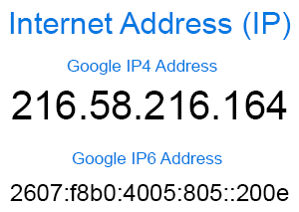
IP Addresses
IP addresses assign an address to every computer on the internet.
There are two types of addresses IPv4 and IPv6.(Kaspersky.com)
ComputerHope.com
Notes:
The source for this information is Kaspersky.com even though I know it already.

Slide 5
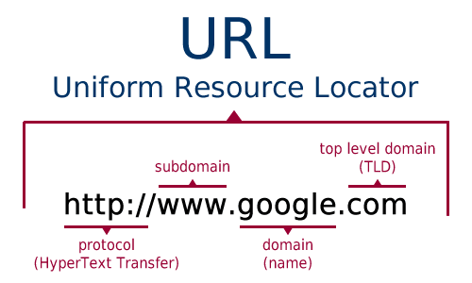
Why are IP addresses rarely seen by the user
IP addresses are hard to remember
Instead, people use URLs to connect to websites
URLs are converted to IP addresses behind the scenes
Webdancers.com

Slide 6
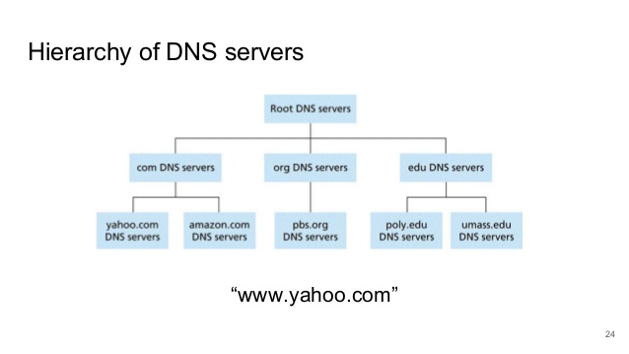
DNS servers
A DNS server’s single purpose is to tell you what IP address goes with a given URL (Networkworld.com).
There are multiple levels to help tell your computer where it can find an answer (Lifewire.com).
SlideShare.com
Notes:
DNS servers are solely designed to convert URLs to IP addresses (Shaw & Fruhlinger)
DNS queries are sent to a DNS server to get a potential answer to where the address of the URL is (Fisher).

Slide 7
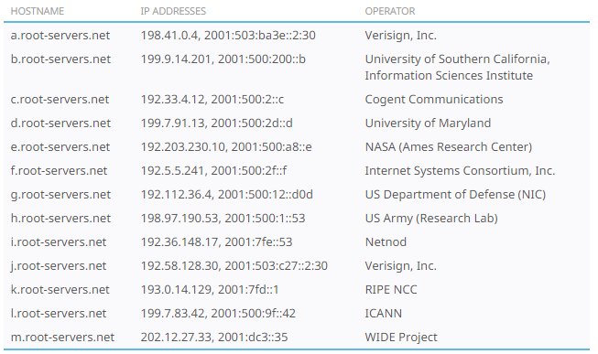
Root DNS servers
Root zone databases keep track of the top-level domains and what servers have them. Ex: .com, .org, .net, etc.
IANA is the organization that keeps track of all this information.
IANA.org
Notes:
When sending a DNS query the DNS server might know ip address but if it doesn’t then it will ask a root server (Jalen)
IANA any information of what servers control what first level domains and the 13 root servers (Root Zone Database).

Slide 8
Actually sending the message
Now we have the URL we want to go to and got it converted to an IP address.
To send A message your computer will form a TCP or UDP connection.
Everything from emails to websites to streaming use these connections.

Slide 9
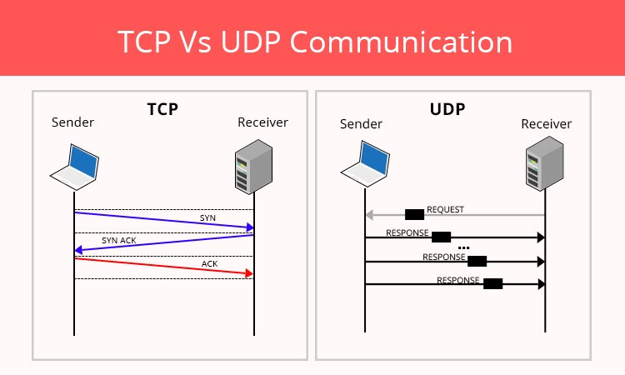
TCP vs UDp
TCP is a two-way connection that is slower but more reliable.
UDP is a one-way connection that is faster and less reliable.
TCP is used for active connections, UDP is used for simple requests for data (IETF).
Sites.google/site/ciscoch9
Notes:
Explain how TCP has to ask for acknowledgement before it can send the message. IETF has documentation over both UDP and TCP

Slide 10
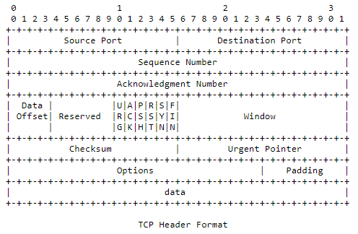
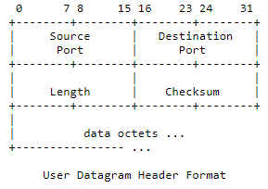
Visual comparison of UDP vs TCP
IETF.org
IETF.org

Slide 11
Conclusion
There are hundreds of steps just to connect to a website that the general public don’t know about.
In order to connect to a website, your computer will first need a URL.
Your computer askes a DNS server what the IP address of the URL is.
Once it has the address your computer can make a UDP or TCP connection depending on the circumstance.
All this happens within a fraction of a second just to keep us connected.

Slide 12
Citations
Fisher, T. (2020, May 8). What You Need to Know About Network DNS Servers. Lifewire. https://www.lifewire.com/what-is-a-dns-server-2625854.
IETF Documents. IETF. (2021, March 9). https://tools.ietf.org/html/.
Jelen, S. (2019, August 13). SecurityTrails: DNS Root Servers: What Are They and Are There Really Only 13? DNS Root Servers: What are they and is there really only 13? https://securitytrails.com/blog/dns-root-servers#:~:text=What%20are%20DNS%20root%20servers%3F&text=The%20mapping%20of%20domain%20names,authoritative%20servers%20of%20all%20TLDs.
Kaspersky. (n.d.). What is an IP Address – Definition and Explanation. www.kaspersky.com. https://www.kaspersky.com/resource-center/definitions/what-is-an-ip-address.
Root Zone Database. IANA. (n.d.). https://www.iana.org/domains/root/db.
Shaw, K., & Fruhlinger, J. (2020, August 26). What is DNS and how does it work? Network World. https://www.networkworld.com/article/3268449/what-is-dns-and-how-does-it-work.html.

